Slide 1

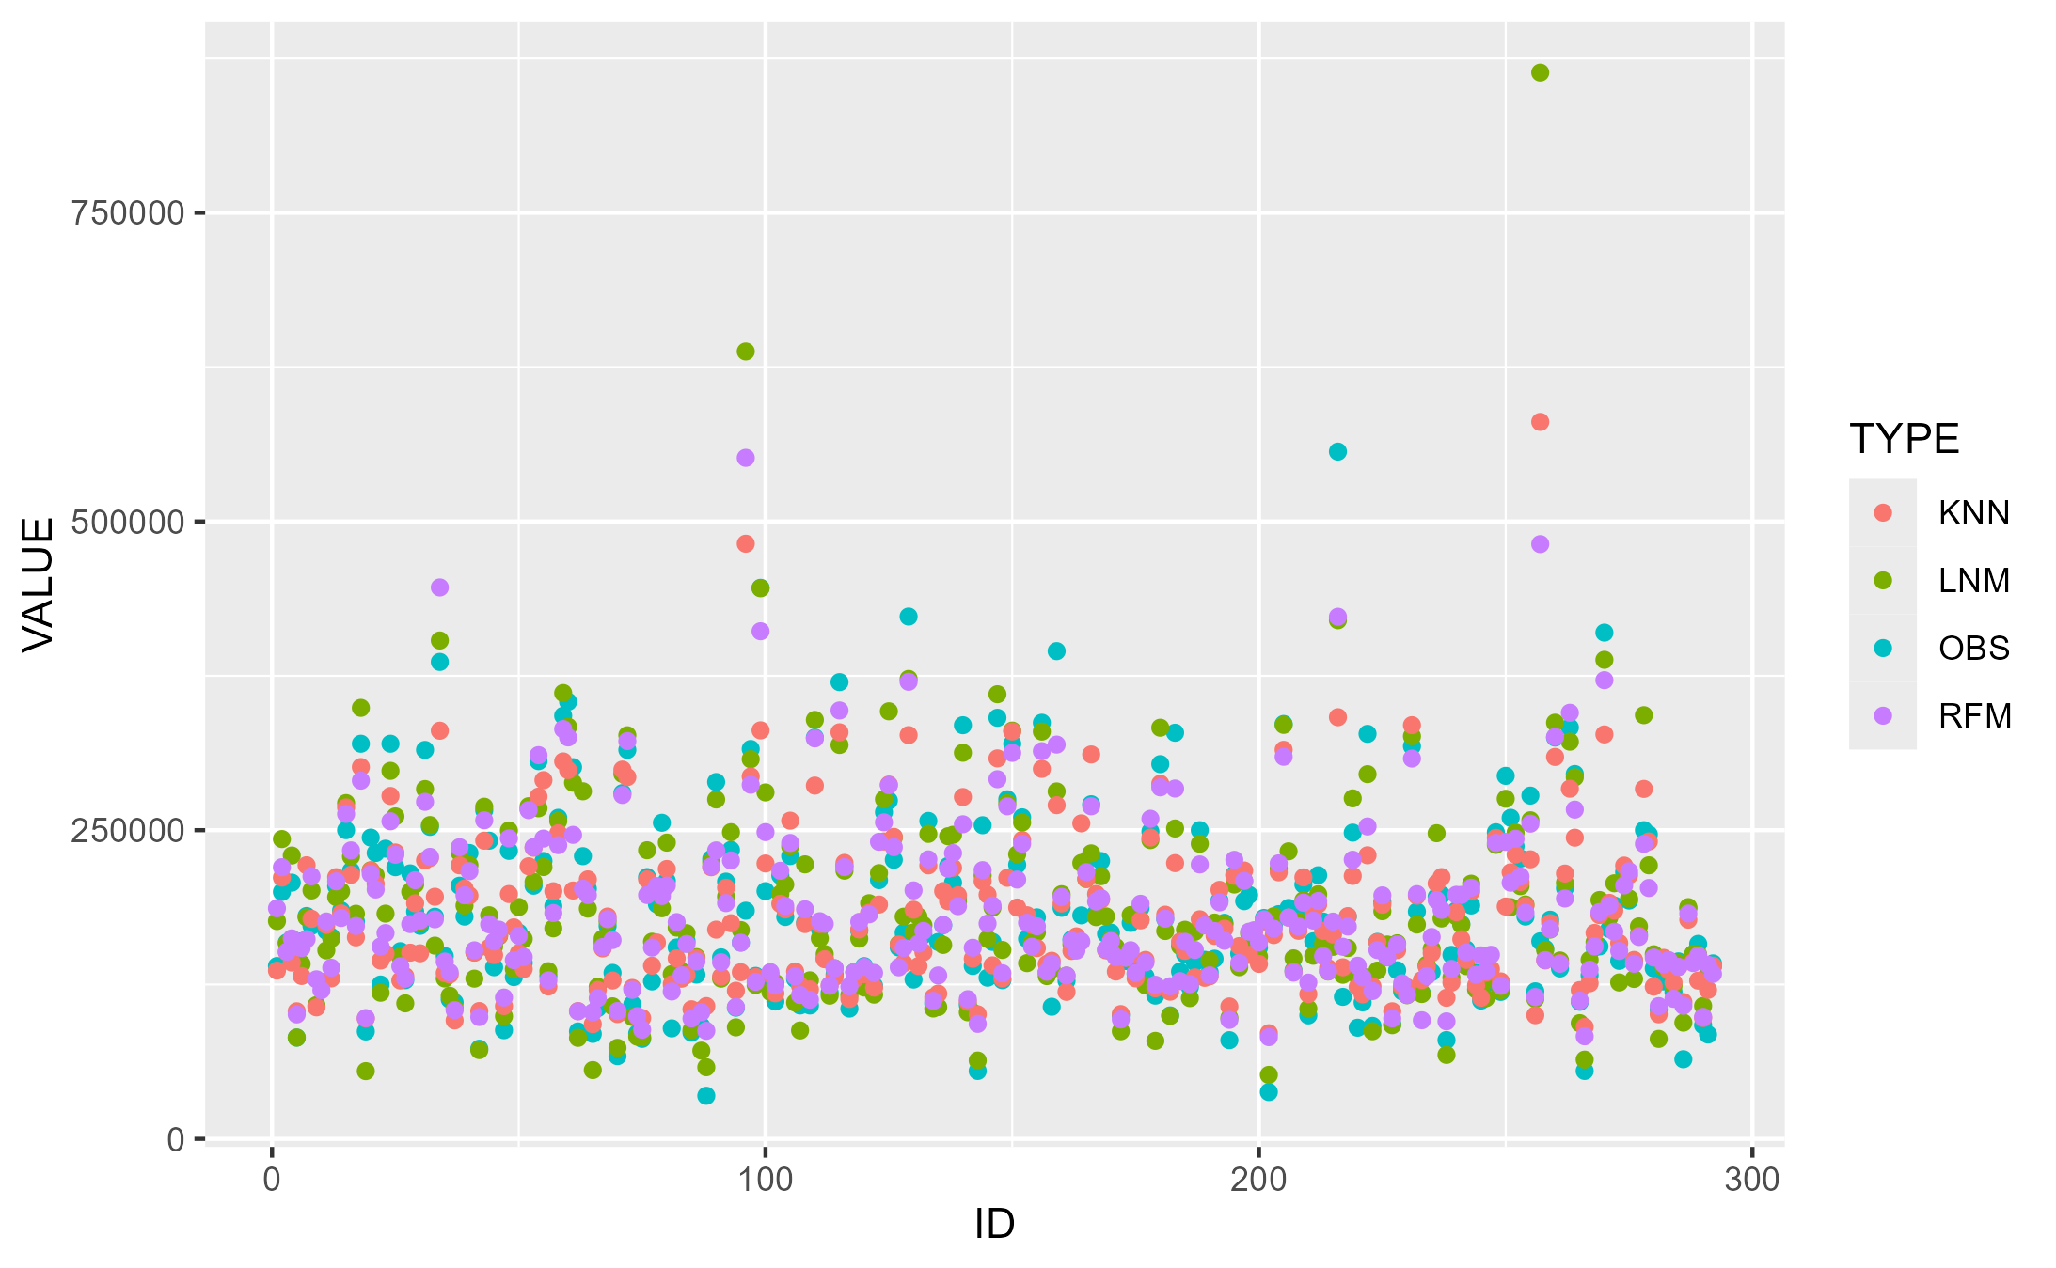
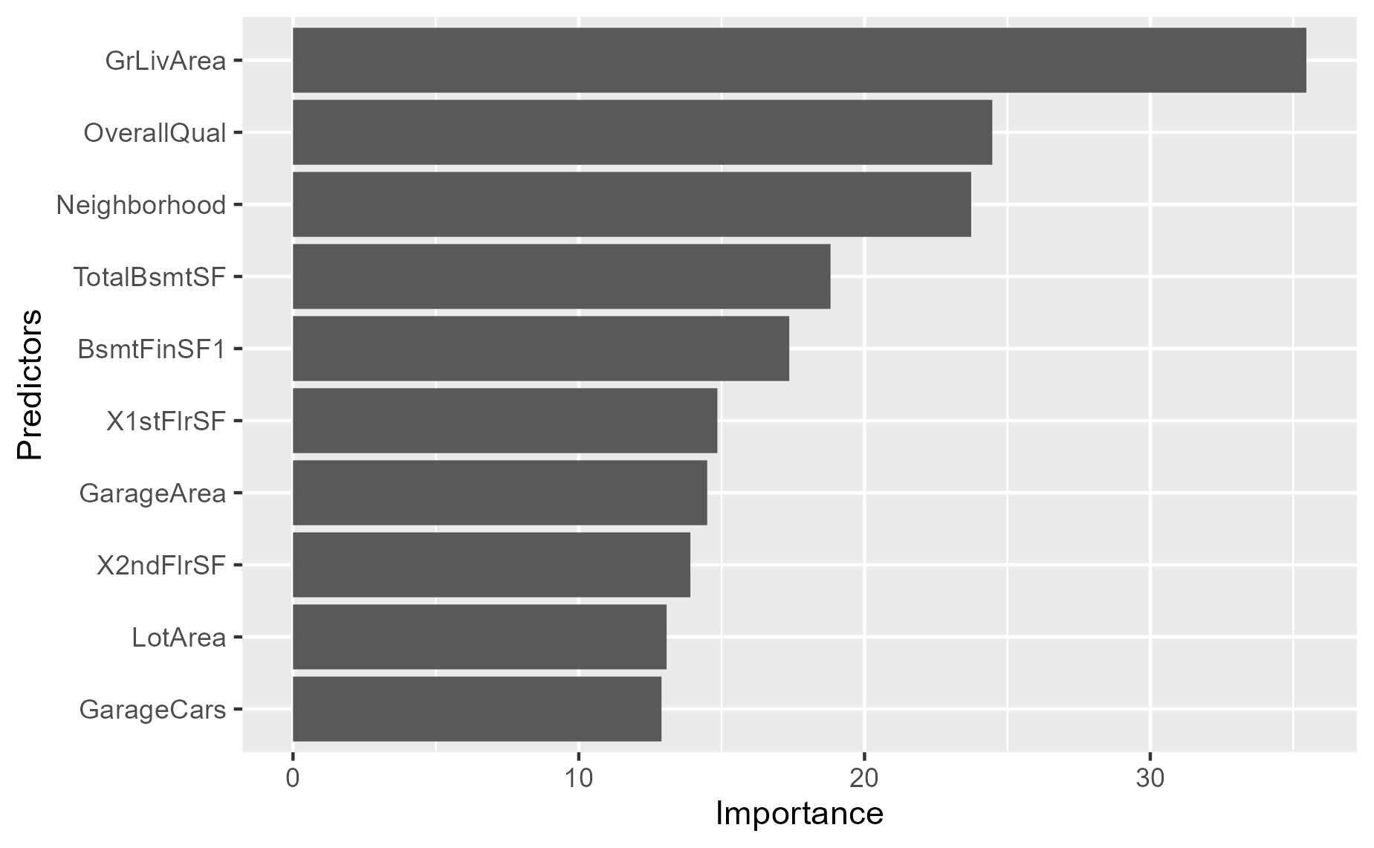
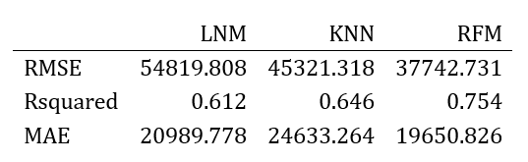
Predicting Housing Prices with Different Machine Learning Models
Antonio Flores
The University of Texas at San Antonio, San Antonio TX, 78249
Abstract
Methods
Results - con’t
Conclusions (Disc. or Summary)
There are many different variables that can affect housing prices which can vary drastically. In order to make best decisions about housing prices, it is useful to be able to predict the sales price of a house given a set of descriptors. This project will seek to identify a model for predicting housing prices using a dataset provided by Kaggle, by comparing the accuracy and predictive power of different machine learning.
There were several different data cleaning methods that were experimented with. First, I removed all variables that had more than 80% NA values. Then for those categorical predictors with some missing values, I replaced those with a "None" value. Next, I converted all the categorical variables to factors (they were initially read in as character values). Once The variables were recognized as factors, I could evaluate which predictors were victim of class imbalance. I removed the predictors with around 80% of observations in one class of a variable. Finally, I replaced the NA values in the numeric predictors with the median value of that variable. When I was finished with the data cleaning portion of this project, I had reduced the data set down from 79 to 63, 26 categorical and 37 numeric variables.
I chose to utilize the following models: the K-Nearest Neighbors model (KNN), Linear Regression model, and RandomForest models to determine the best prediction model for this project.
The KNN model predicts based on the closest samples or neighbors. K represents the number of neighbors to utilize to come to the conclusion (@kuhn2018).
Linear Regression focuses on minimizing the SSE (Sum of squared errors) between the predicted and original response value.
RandomForest models take advantage of decision trees (@IBM).
The performance metrics I will be assessing are R^2, RMSE, and MAE.
R-Squared (R^2) - This value explains what percent (proportion) of the total variance in the data is explained by the model.
RMSE (Root Mean Squared Error): Represents the average size of the difference between real values and the predicted values
MAE (Mean Absolute Error): Similar to RMSE, but the absolute value of the difference between real and predicted is used.
Predicted Values Compared to Observed Values
The chosen models displayed quality predictive power.
The RandomForest model yielded the best metrics.
Due to the smaller size of the data set, the results were not as conclusive as would be desired
The Overall Quality and General Living Area Square Footage were the two predictors that were listed in all three models as important contributors to prediction power.
Both the models and their variables of importance could be beneficial for interested parties looking to accurately identify the sales prices of houses
Further research: Verifying reproducibility of results with a larger data set containing more unique observations. Using housing data for a different general location could also be useful in determining whether the results presented here are indicative of most areas or if they are subject to localized bias.
Introduction (Background)
Machine learning models provide a massive opportunity for real estate investors to identify housing prices by using a set of predictors. This project will utilize Regression Prediction. Unlike Classification Prediction which will attempt to predict a classifier based on given predictors, Regression Prediction seeks to identify a continuous value (e.g., x amount of dollars, x number of cells). In our case, our response variable is a continuous variable, the sales price of a house.
There are 1,460 records, 81 columns/variables. There is an ID column, as well as a response value, meaning there are 79 predictors, which include descriptors of the house in question. These include both categorical predictors as well as numerical predictors. Areas described by the predictors include, Basements, Garages, Bathrooms, Location, Age, and many, many others. Additionally, as mentioned, the response variable is the sales price of the house.
Figure 1 shows the distribution of predicted values for each model, overlayed with the real observed values (OBS).
References
IBM. (n.d.). What is random forest?
2 Kuhn, &. J., M. (2018). Applied predictive modeling.
,
Variable Importance for RandomForest Model
Results
Purpose (Objective, Aim, Goal)
Acknowledgements
The research question I plan to address with my analysis is: which features are the best predictors of housing prices? Additionally, the desired output of this analysis is a machine learning model which allows real estate investors or other interested stakeholders to better prioritize/make decisions regarding future real estate purchases.
This project was carried out as part of the general requirements for the course: STA-6543-01T-202430 Predictive Modeling taught by Dr. Min Wang
The RandomForest model performed the best of the three models, outputting the best results by a fairly considerable margin, in all three categories. The KNN model performed the second best of the three, but was closer to the Linear Model's results than to the RandomForest model
Figure 2 shows the variables that are listed as most important (that is, having the greatest weight) in terms of increasing prediction power. These are the results for the RandomForest model which were very similar t o those observed by the KNN model.

Slide 2
Predicting Housing Prices with Different Machine Learning Models
Antonio Flores
The University of Texas at San Antonio, San Antonio TX, 78249
Abstract
Methods
Results - con’t
Conclusions (Disc. or Summary)
There are many different variables that can affect housing prices which can vary drastically. In order to make best decisions about housing prices, it is useful to be able to predict the sales price of a house given a set of descriptors. This project will seek to identify a model for predicting housing prices using a dataset provided by Kaggle, by comparing the accuracy and predictive power of different machine learning.
There were several different data cleaning methods that were experimented with. First, I removed all variables that had more than 80% NA values. Then for categorical predictors with some missing values, I replaced those with a "None" value. Next, I converted all the categorical variables to factors (they were initially read in as character values). Once The variables were recognized as factors, I could evaluate which predictors were victim of class imbalance. I removed the predictors with around 80% of observations in one class of a variable. Finally, I replaced the NA values in the numeric predictors with the median value of that variable. When I was finished with the data cleaning portion of this project, I had reduced the data set down from 79 to 63, 26 categorical and 37 numeric variables.
I chose to utilize the following models: the K-Nearest Neighbors model (KNN), Linear Regression model, and RandomForest models to determine the best prediction model for this project.
The KNN model predicts based on the closest samples or neighbors. K represents the number of neighbors to utilize to come to the conclusion (@kuhn2018).
Linear Regression focuses on minimizing the SSE (Sum of squared errors) between the predicted and original response value.
RandomForest models take advantage of decision trees (@IBM).
The performance metrics I will be assessing are R^2, RMSE, and MAE.
R-Squared (R^2) - This value explains what percent (proportion) of the total variance in the data is explained by the model.
RMSE (Root Mean Squared Error): Represents the average size of the difference between real values and the predicted values
MAE (Mean Absolute Error): Similar to RMSE, but the absolute value of the difference between real and predicted is used.
Predicted Values Compared to Observed Values
The chosen models displayed quality predictive power.
The RandomForest model yielded the best metrics.
Due to the smaller size of the data set, the results were not as conclusive as would be desired
The Overall Quality and General Living Area Square Footage were the two predictors that were listed in all three models as important contributors to prediction power.
Both the models and their variables of importance could be beneficial for interested parties looking to accurately identify the sales prices of houses
Further research: Verifying reproducibility of results with a larger data set containing more unique observations. Using housing data for a different general location could also be useful in determining whether the results presented here are indicative of most areas or if they are subject to localized bias.
Introduction (Background)
Machine learning models provide a massive opportunity for real estate investors to identify housing prices by using a set of predictors. This project will utilize Regression Prediction. Unlike Classification Prediction which will attempt to predict a classifier based on given predictors, Regression Prediction seeks to identify a continuous value (e.g., x amount of dollars, x number of cells). In our case, our response variable is a continuous variable, the sales price of a house.
There are 1,460 records, 81 columns/variables. There is an ID column, as well as a response value, meaning there are 79 predictors, which include descriptors of the house in question. These include both categorical predictors as well as numerical predictors. Areas described by the predictors include, Basements, Garages, Bathrooms, Location, Age, and many, many others. Additionally, as mentioned, the response variable is the sales price of the house.
Figure 1 shows the distribution of predicted values for each model, overlayed with the real observed values (OBS).
References
IBM. (n.d.). What is random forest?
2 Kuhn, &. J., M. (2018). Applied predictive modeling.
,
Variable Importance for RandomForest Model
Results
Purpose (Objective, Aim, Goal)
Acknowledgements
The research question I plan to address with my analysis is: which features are the best predictors of housing prices? Additionally, the desired output of this analysis is a machine learning model which allows real estate investors or other interested stakeholders to better prioritize/make decisions regarding future real estate purchases.
This project was carried out as part of the general requirements for the course: STA-6543-01T-202430 Predictive Modeling taught by Dr. Min Wang
The RandomForest model performed the best of the three models, outputting the best results by a fairly considerable margin, in all three categories. The KNN model performed the second best of the three, but was closer to the Linear Model's results than to the RandomForest model
Figure 2 shows the variables that are listed as most important (that is, having the greatest weight) in terms of increasing prediction power. These are the results for the RandomForest model which were very similar t o those observed by the KNN model.

